Slide 1
Database Internals
For Noobs

Slide 2
Why have a career in Database Systems
It’s the now and future
People look less for simple DBAs who write SELECT
$$$$$$$ ;)

Slide 3
A Brief History
Interesting too!

Slide 4
Where it all started
1960s, The birth of database systems
IBM’s IMS (Information Management System)
CODASYL
System R – IBM
Ingres – U.C. Berkley
Oracle – Larry Ellison

Slide 5
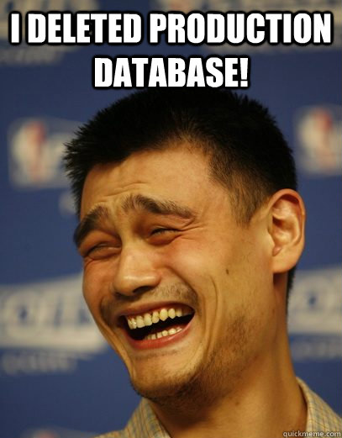

Slide 6
Relational Model Wins (1980s)
IBM releases DB2 1983 and SQL becomes the standard
Oracle wins the market
Postgres created by Michael Stonebraker

Slide 7
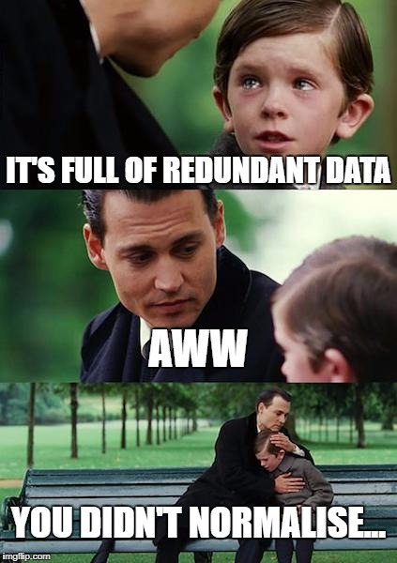

Slide 8
SELECT *
FROM Fired_Employees

Slide 9
SELECT *
I see this (in most cases) = I kill you
Anyone else sees this (in most cases) = they kill you
Why would anyone kill you over SELECT * ?

Slide 10
Avoiding Maintenance? HAH!
Use Views with SELECT *! Look at me, I am smart!
↑ This guy gets killed first and then fired.
Let me show you why he isn’t as smart as he thinks he is.

Slide 11

Index is love, Index is life
Company
YOU
Index
But don’t overdo it

Slide 12
Index Only Scan
Scans only the index(s)
Indexes aren’t always good
Let me show you why

Slide 13
Introduction to Hash Tables
Static Hash Tables

Slide 14
What are Hash Tables in general?
Hash Tables are part of Data Structures
Hash Tables are like a Library
As the name suggests, it Hashes data

Slide 15
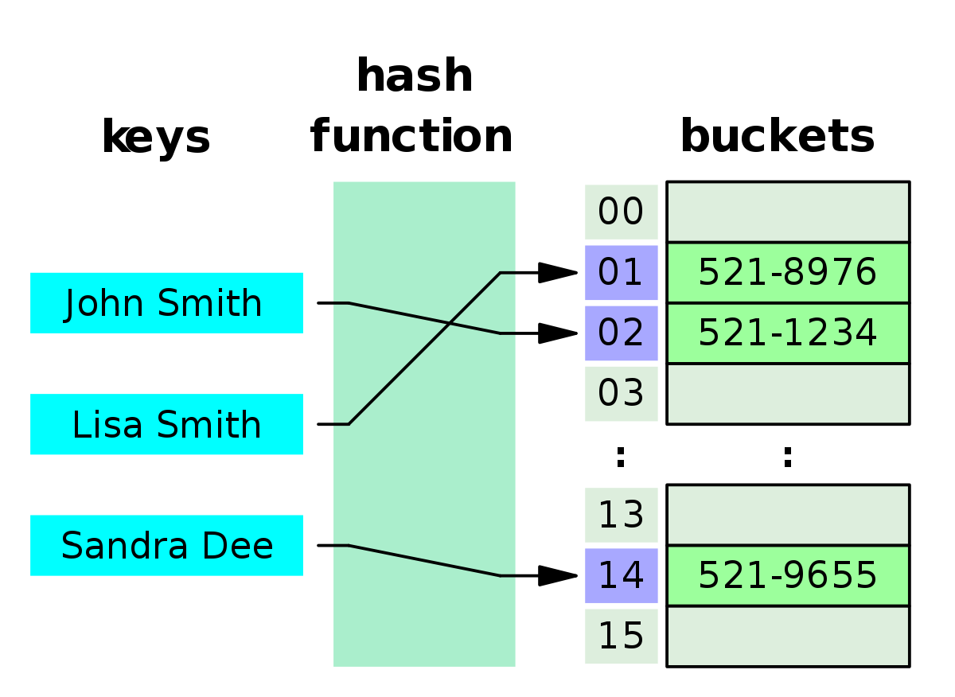
Static Hash Tables
Hashes every single field
Has major issues, can you guess them?

Slide 16
Where to use Static Hash Tables
When you know the exact amount of elements ahead of time
When you know that each key is unique
And that it is a Perfect Hash Function

Slide 17
Introduction to Serializability Theory
Serial and non-serial scheduling
(much simpler than it sounds)

Slide 18
What is the basic theory of serializability
It basically says that non-serially-scheduled transactions should have the same result as a serial scheduled one

Slide 19
What is Serializability
It is a classical concurrency control scheme
Concurrency control is a process to ensure data is updated correctly when multiple transactions are executed
Why would you have concurrency control to begin with?

Slide 20
Serialized Scheduling
Limits the number of concurrencies you can do
Causes CPU waste
Very simple transactions can sometimes wait a long time

Slide 21
Non-Serialized Scheduling
Correctness check
If it passes the check, it is Serializable
For research: Conflicts

Slide 22
Where the world is now
And extra research topics

Slide 23
Where the world of DBMS is now
What is OLTP and OLAP and what are their problems?
HTAP – Hybrid Transactional-Analytical Processing

Slide 24
Extra research topics
What goes around, comes around – Michael Stonebraker
What is actually new with NewSQL – Andrew Pavlo
A Relational Model of Data for Large Shared Data Banks – Ted Codd
Optimization of Code
Indexing

Slide 25
SELECT *
FROM Student.Questions

